Slide 1
SUPER
SAMPLING
Abe Gizaw, Brian Pascente

Slide 2
Agenda
1.
What is Supersampling -Abe
2.
Demo + What We accomplished - Brian
3.
State of the Art - Abe
4.
How we measured results - Brian
5.
What we learned + Next Steps - Both

Slide 3
Agenda
1.
What is Supersampling
2.
Demo + What We accomplished
3.
State of the Art
4.
How we measured results
5.
What we learned + Next Steps

Slide 4
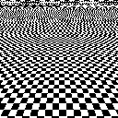
Supersampling
What is Supersampling
How It Works:
The ray tracer casts multiple rays per pixel.
The colors from these rays are blended to determine the final pixel color.
Higher sampling rates result in better image quality but increase computational cost.
Notes:
Super sampling is an anti-aliasing technique that improves image quality by taking multiple samples per pixel and averaging them to produce smoother transitions and reduce artifacts like jagged edges.

Slide 5
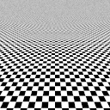
What is Supersampling
No Anti-aliasing
Aliasing

Slide 6
Types of Supersampling we used
What is Supersampling
Sampling Methods:
Uniform Sampling
Jittered Sampling
Filtering Techniques:
Box Filter
Gaussian Filter
Use:
Sampling – Determines where to collect color information from the scene.
Filtering – Combines sampled data to produce the final pixel color.
Notes:
Sampling Methods:
Uniform Sampling: Samples are evenly spaced in a grid (used during tracing and post-processing).
Jittered Sampling: Samples are randomly perturbed within the pixel grid (only during tracing).
Filtering Techniques:
Box Filter: Averages all samples equally.
Gaussian Filter: Weighs samples based on a Gaussian distribution, giving more importance to central samples.

Slide 7
Agenda
1.
What is Supersampling
2.
Demo + What We accomplished
3.
State of the Art
4.
How we measured results
5.
What we learned + Next Steps

Slide 8
DEMO

Slide 9
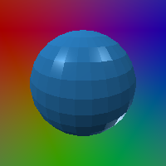
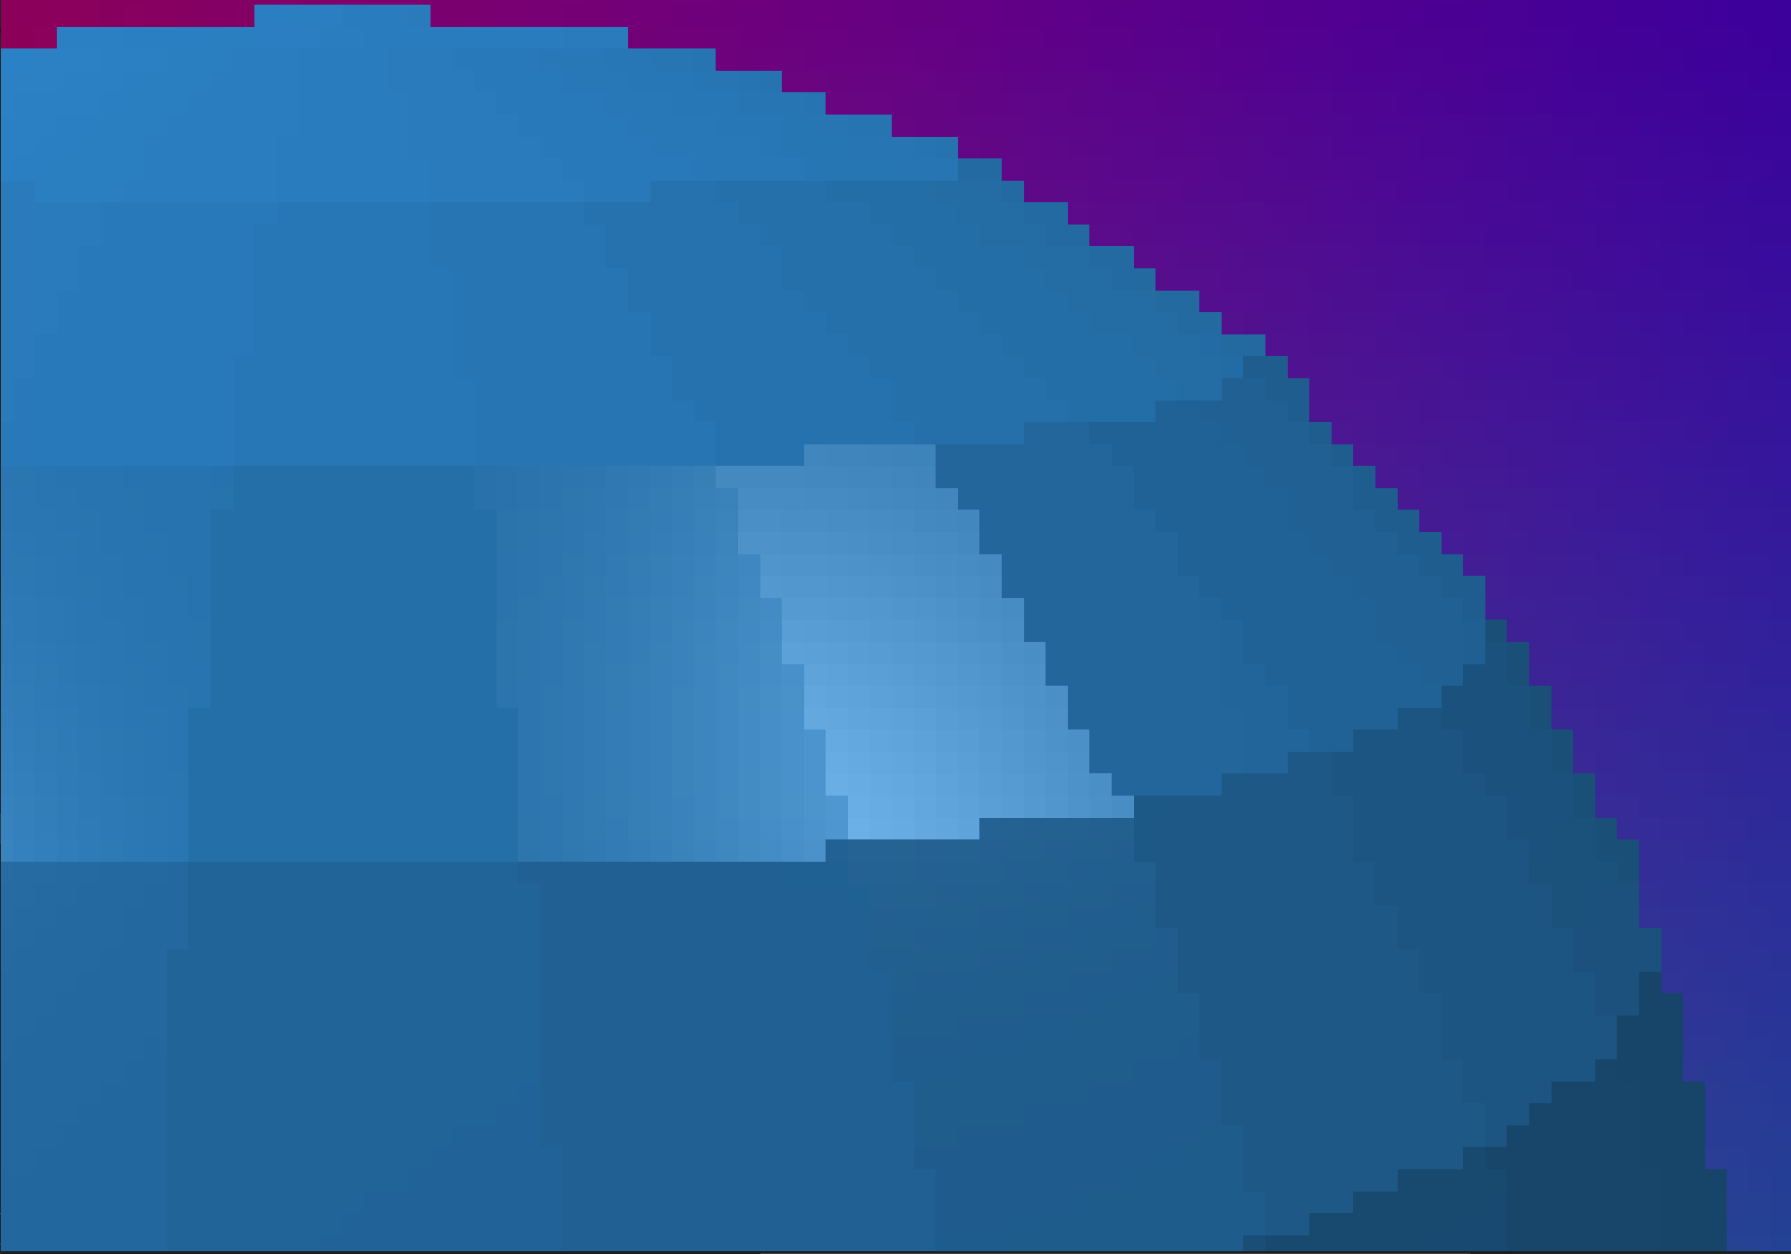
Original Image
What is Supersampling
200x200 blue spheres.obj

Slide 10

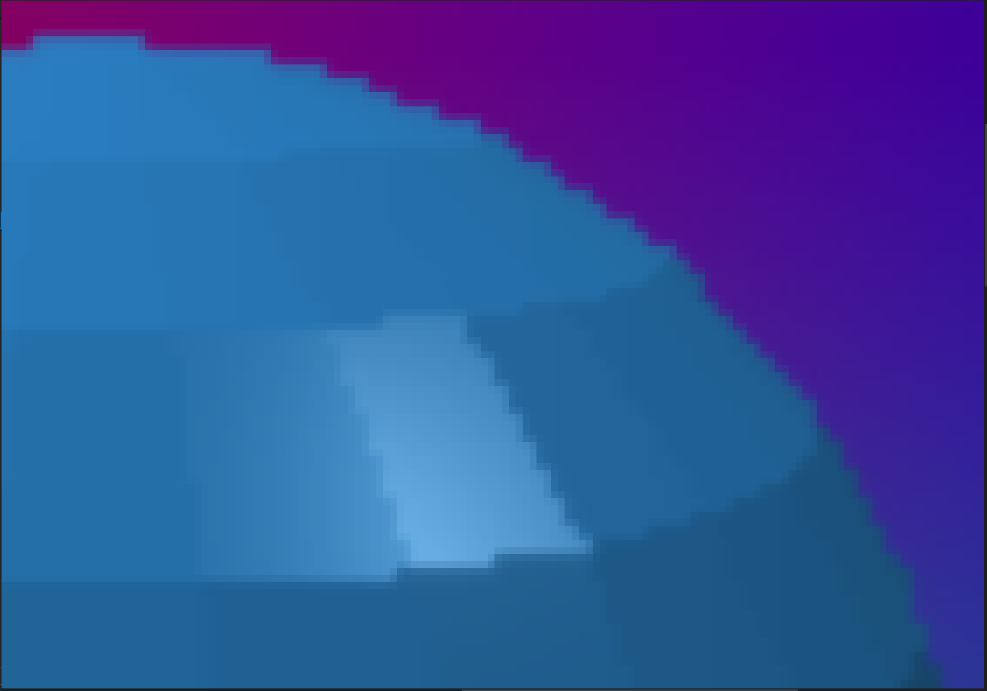
Box Filter After Rendering
What is Supersampling
Used Box Filter on the output image after rendering
(400x400)
Notes:
Did this one first, kind of works but could be better

Slide 11
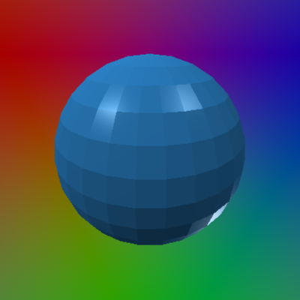
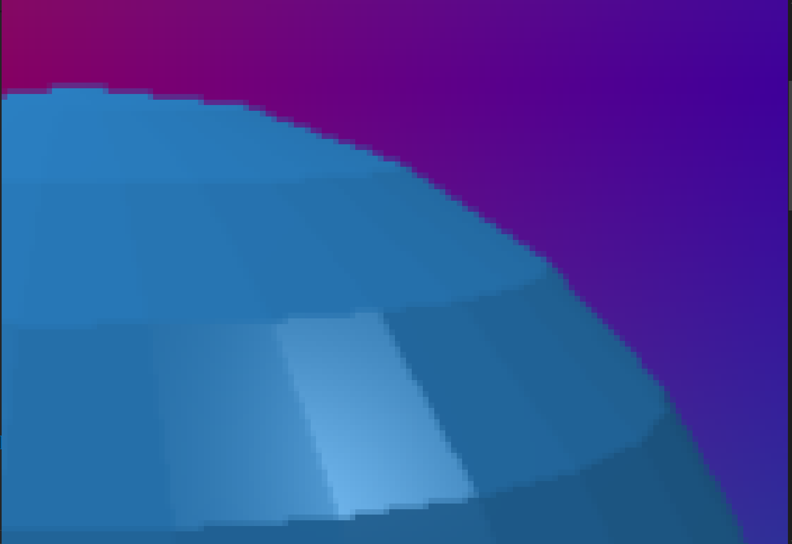
Box Filter while rendering
What is Supersampling
(400x400) (uniform sampling)
Notes:
Look much better, but can see the background blending in w/the edge

Slide 12

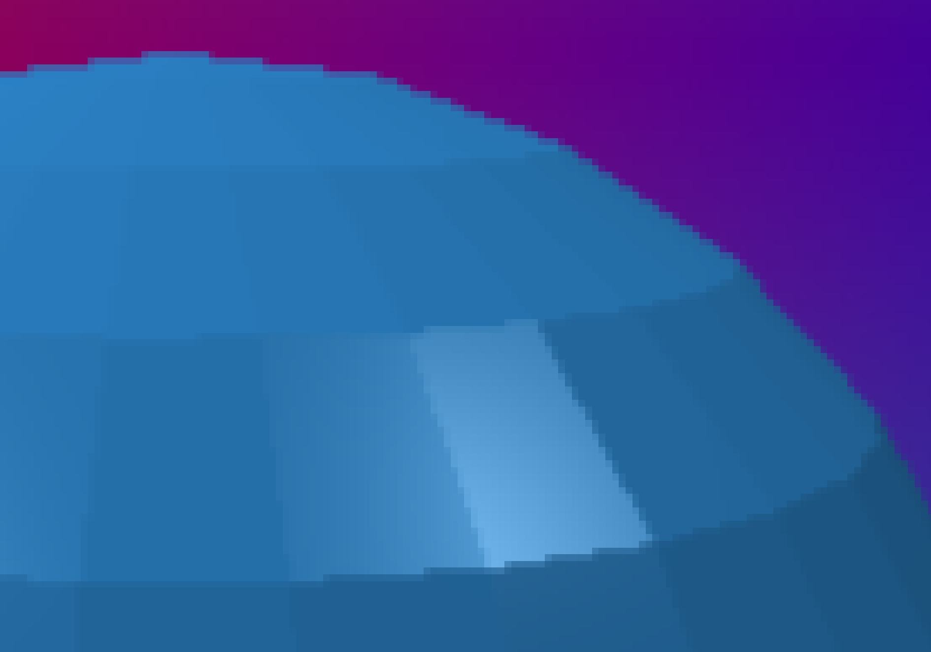
Gaussian Filter while rendering
What is Supersampling
(400x400) (Kernel size 3x3, σ=1) (uniform sampling)
Notes:
Looks similar, but background blends in w/edges

Slide 13
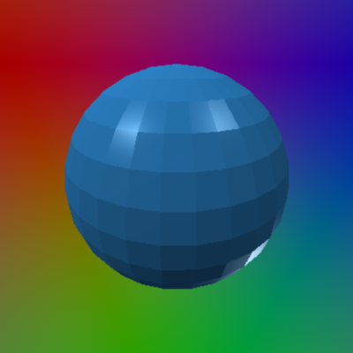

Gaussian Filter while rendering
What is Supersampling
(400x400) (Kernel size 9x9, σ=3) (uniform sampling)
Notes:
Looks similar,changed size and intensity a little, only a slight difference

Slide 14
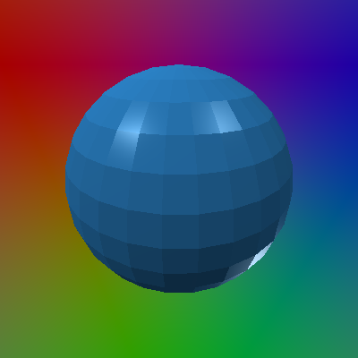
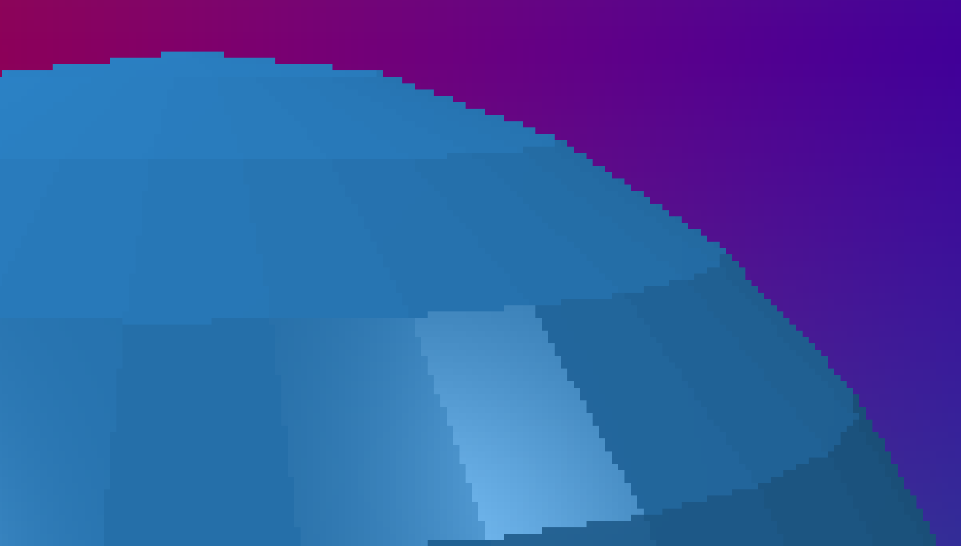
Box Filter while Rendering (Jittering Sample)
What is Supersampling
(400x400)
Notes:
Looks much better, smoother, background does not blend in w/background

Slide 15

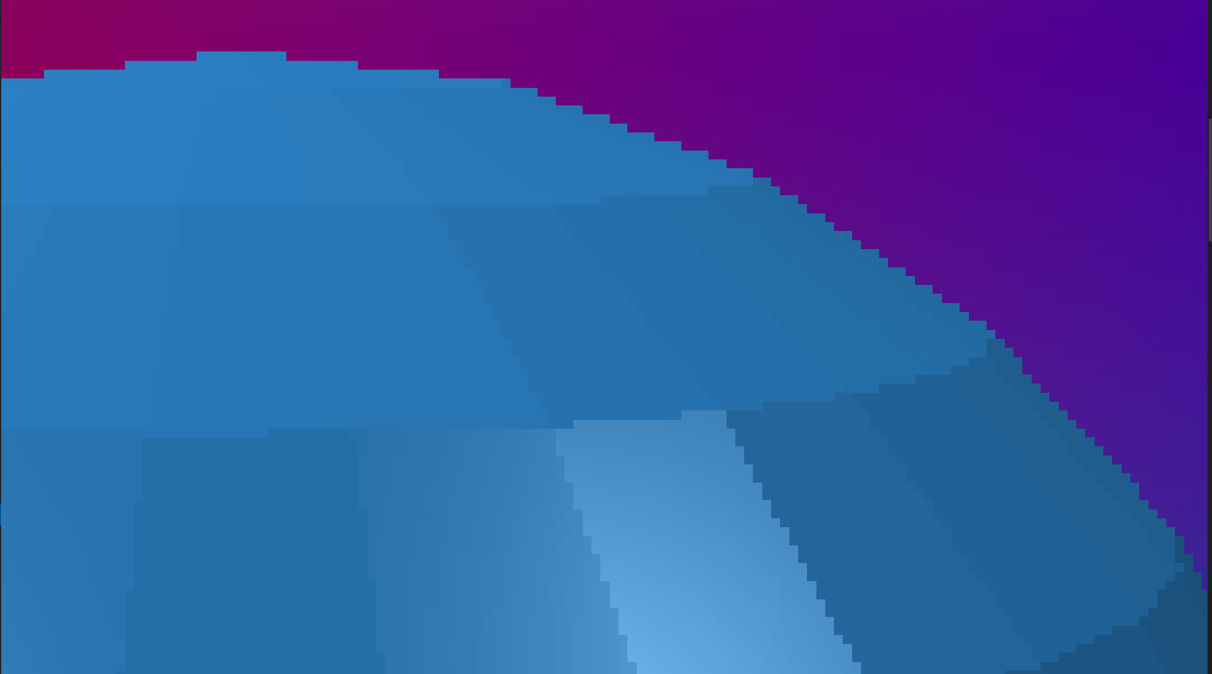
Gaussian Filter while Rendering (Jittering Sample)
What is Supersampling
(400x400) (Kernel size 3x3, σ=1)
Notes:
Same thing: Looks much better, smoother, background does not blend in w/background

Slide 16
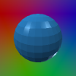
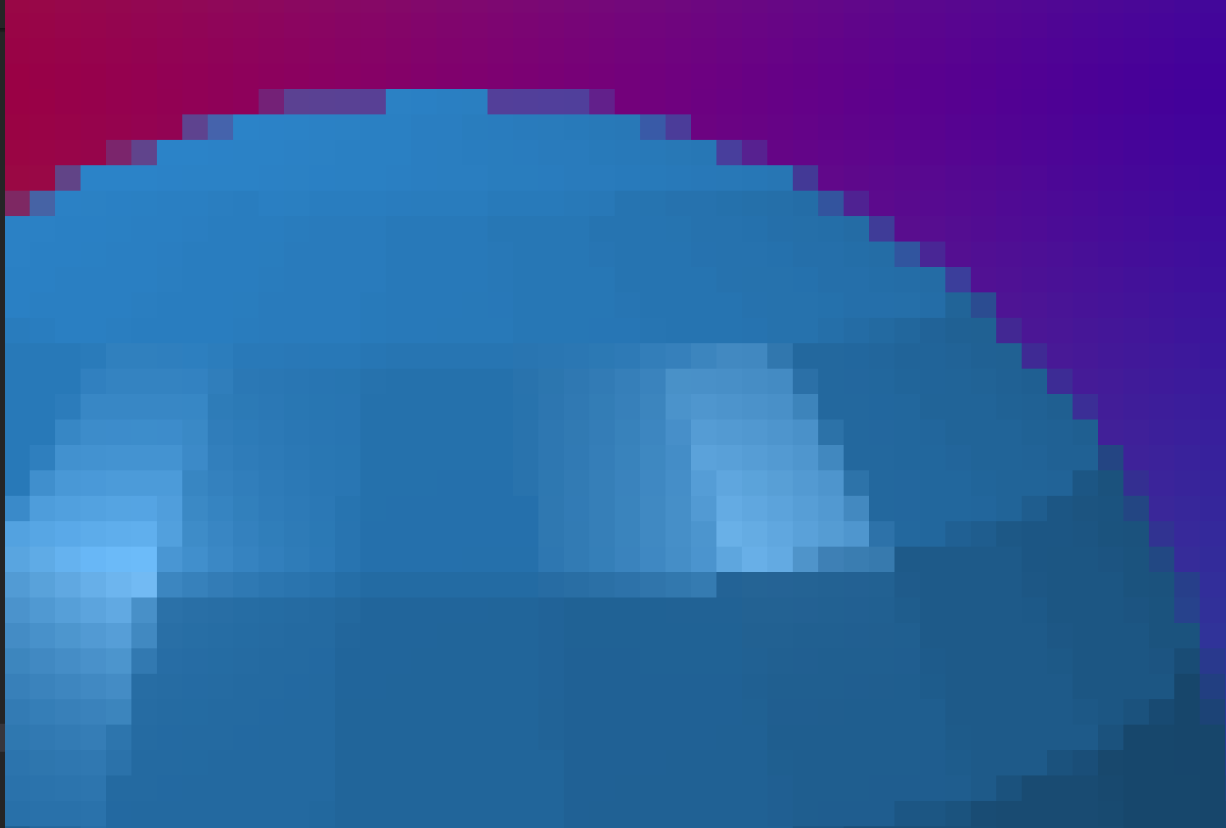
Downsampling
What is Supersampling
200x200 blue spheres.obj
->100x100 blue spheres
Notes:
Thought it would be interesting to see what happens if we downsampled

Slide 17
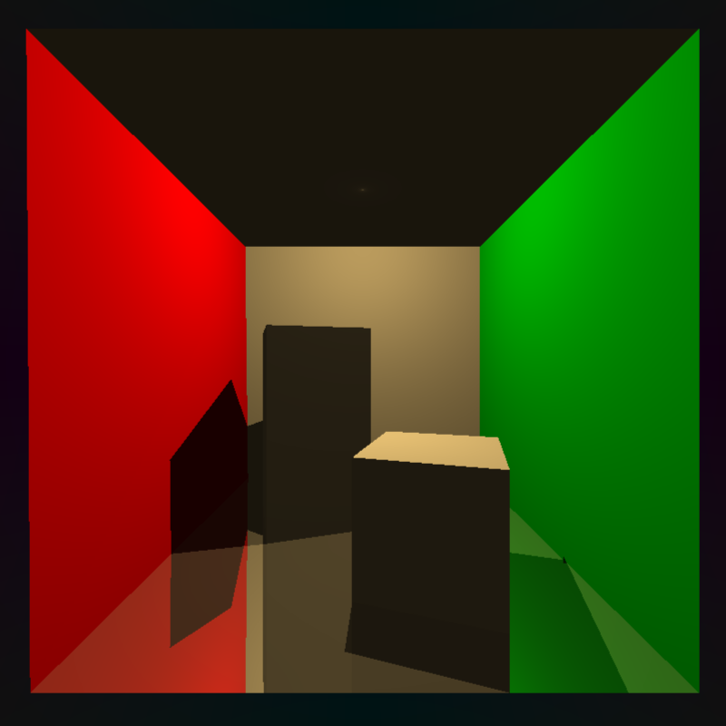


Accomplishments
What we Accomplished
Box Filter Uniform Sampling (800x800)
Able to accomplish super-sampling with multiple different methods
Original (400x400)
Gaussian Filter Jitter Sampling (800x800)
Notes:
Many combinations of blurring and sampling, if it’s a gaussian blur you can adjust the kernel size and the strength of it, allows the user to choose their favorite combination

Slide 18
Agenda
1.
What is Supersampling
2.
Demo + What We accomplished
3.
State of the Art
4.
How we measured results
5.
What we learned + Next Steps

Slide 19
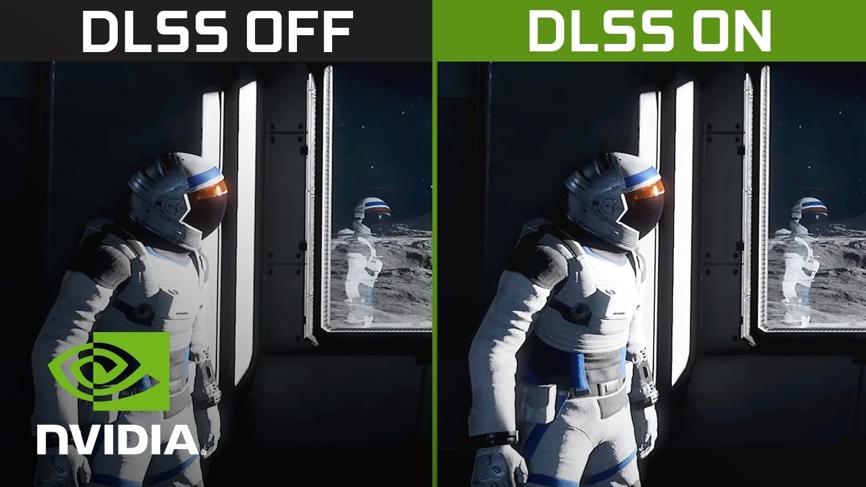
State of the Art
State of the Art
Uses
NVIDIA's Deep Learning Super Sampling (DLSS)
Intel XeSS.
Current work in supersampling primarily focus on using AI techniques to improve image quality
Notes:
NVIDIA's Deep Learning Super Sampling (DLSS 4) which leverages neural networks to upscale lower resolution images to higher resolutions with minimal quality loss; this allows for higher visual fidelity in games while maintaining frame rates.
Only available on Nvidia Hardware
Temporal super sampling:
Utilizing information from previous frames to enhance the quality of upscaled images, especially in motion-heavy scenes.

Slide 20
Agenda
1.
What is Supersampling
2.
Demo + What We accomplished
3.
State of the Art
4.
How we measured results
5.
What we learned + Next Steps

Slide 21
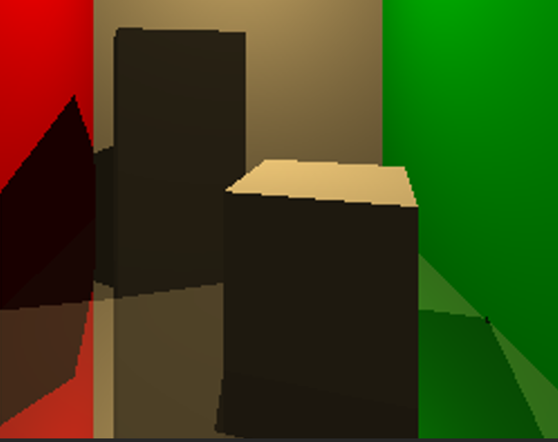
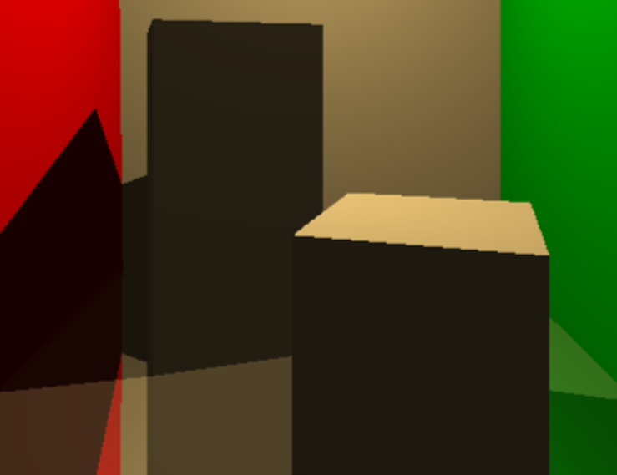
Results
How we Measured Results
We measured results by mainly comparing the images side by side
Cornell box 400x400 original (left) and Box Filter Uniform Sampling 800x800 (right)
Notes:
Eyeballed quality of the results, we did good if it looks good. Mainly looking for diagonal jaggy edges and how it made it smooth like the image on the right

Slide 22
Agenda
1.
What is Supersampling
2.
Demo + What We accomplished
3.
State of the Art
4.
How we measured results
5.
What we learned + Next Steps

Slide 23
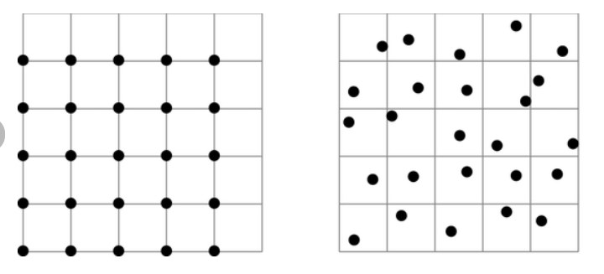
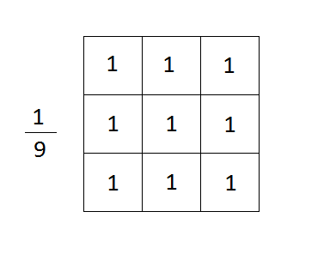

What we Learned
What we Learned + Next Steps
Super sampling
Difference between applying filters during and after rendering
Different implementation of blurring (Averaging vs Gaussian)
Different version of Sampling (Uniform vs Jitter)
Undersampling
Notes:
Uniform vs Jitter (top), box filter (middle), and the equation I used for gaussian blur (bottom)

Slide 24
Next Steps
What we Learned + Next Steps
Easy / Medium:
Triangle Filter
Stratified Sampling
Poisson Disk Sampling
Hard:
Adaptive Sampling
Machine Learning
Notes:
Triangle Filter: Similar to a box filter but gives more weight to samples near the center of the pixel, reducing blurring.
Smoother than box filtering, but still easy to implement.
Stratified Sampling: Instead of fully random jittered sampling, this divides each pixel into a grid of subregions and takes one random sample per subregion to ensure better coverage.
Reduces clumping that can happen with full jittered sampling.
Poisson Disk Sampling: A technique for generating a set of points that are randomly distributed but maintain a minimum distance from each other, creating a more natural and uniform pattern compared to random sampling.
Adaptive Sampling: Instead of always taking the same number of samples per pixel, increase samples in high-contrast areas (edges, detailed textures) and decrease in smooth areas.
Optimizes performance by avoiding unnecessary samples in uniform areas.
ML: Uses a neural network to predict higher-resolution pixel values based on low-resolution input.
foundation behind NVIDIA DLSS and Intel XeSS.

Slide 25
Thank you!

